Slide 1

Discover Golf
An Green Experience

Slide 2
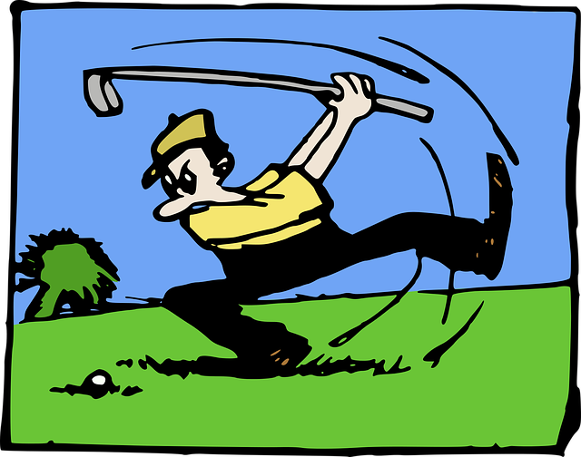
Experience Golf
Have you ever wondered what it is like to play golf? If you want to find out, join us for a unique experience.
Learn the Basics of Golfing
How to use the various clubs
Hit golf balls for the very first time
Explore different aspects of a golf course

Slide 3






Enrollment Prerequisites
Must be at least 10 years old
Complete a Questionnaire
Provide your own golf clubs and balls
Pay $75

Slide 4
Choose from Six Class Times!
Saturdays (accommodate up to 20 golfers)
Wednesdays and Fridays
(limited to 10 golfers)
Choose a Day | Group A 8am – 11am | Group B 2pm – 5pm
Saturday | 15 | 15
Wednesday | 10 | 10
Friday | 10 | 10

Slide 5

The Workshop
Theory – classroom session to teach basic golfing rules
Skills – taught on driving range and shady 9-hole golf course
Play – apply both the theory and skills !

